Slide 1
Phishing URLs Detection
Reef Amarin
Reef.Amarin@htu.edu.jo

Slide 2
Project Objective(s) & Deliverables
Objectives
01
Detecting phishing URLs and websites including shorten URLs, in a way it can be to eliminate phishing cases threats.
Deliverables
02
A notebook and report with all findings about the correlation between text input regex and if the URL could be a phishing or not.
PPT presentation to discuss objectives and findings.
ReefAmarin/Capstone-Project-HTU-Reef.Amarin (github.com)

Slide 3


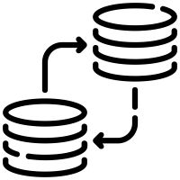

Dataset Description
Dependent and Independent Variables
Records Description
About 500,000 records of clean or defected URLs.
.
First Independent field is a free string (URL) cleaned.
Second field is categorial data dependent variable labeled the first field to two types “label” (bad , good).
Source
SECURITY
A Data Scientist:
“Tarun Tiwari”
he did some web surfing and found some websites offering malicious links
Last Updated
Last updated :2020-07-21

Slide 4
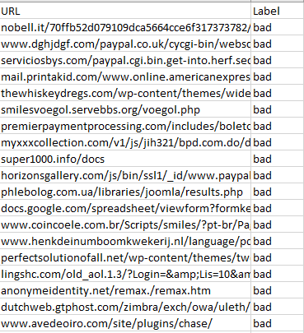
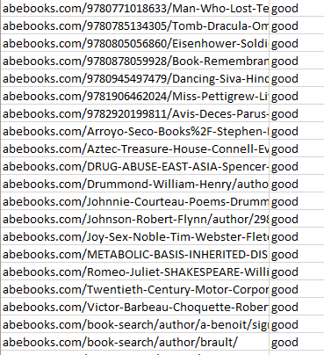
Dataset

Slide 5
Problem Statement
Phishing Attack
Is a type of social engineering attack often used to steal user data, including login credentials and credit card numbers.
It occurs when an attacker pretended as a trusted authorized entity (ex. your bank), fools a victim into opening an email, instant message, or text message and send their information.
!

Slide 6
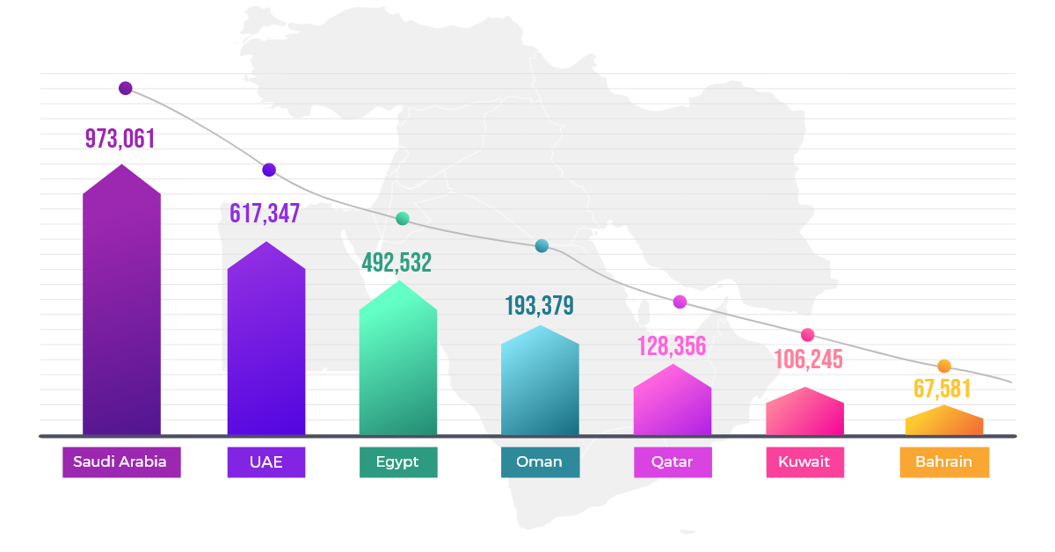
Phishing Attack Statistics Arab World
New security research revealed that the Middle East suffered more than 2.57 million phishing attacks in the second quarter of 2020.
These attacks were detected from April 2020 till the end of June 2020, across several regions of the Middle East.
The biggest Arab economy, Saudi Arabia, saw 973,061 phishing attacks during the second quarter of 2020. (see figure)
(Source of data: The National)

Slide 7

Phishing Attack Statistics Globally
75%
75% of organizations around the world experienced a phishing attack in 2020, and 74% of attacks targeting US businesses were successful.
(Source: Proofpoint)
75x
There are now nearly 75x more phishing sites as there are malware sites.
40%
In 2020, six out of ten mid-sized UK businesses were hit by fraud, suffering losses of £245,000 pounds, with 40% noting an increase from previous years.
(Source: BDO)

Slide 8
State of Art
A supervised tech. by using a classification Types:
MultinomialNB
Applying Multinomial Naive Bayes to NLP problems.
Naive Bayes Classifier algorithm is a family of probabilistic algorithms based on applying Bayes.
Logistics Classification Model.
Was the winner one with high accuracy 95.6%.

Slide 9
Contribution
Detecting phishing URLs including shorten URLs and classifying them as phishing or good.
Find an balanced accurate prediction between different models.
Cleaning all not well-represented URLs data (by token regex).
Find the best models between proposed before.

Slide 10
Machine learning Modules used
Our target is to classify and detect phishing URLs, so the model I have used is Classification Models
Passive-aggressive-classifiers:
Passive: If the prediction is correct, keep the model and do not make any changes. i.e., the data in the example is not enough to cause any changes in the model.
Aggressive: If the prediction is incorrect, make changes to the model. i.e., some change to the model may correct it.
If you want to work on big data, this is a very important classifier and since our dataset is over than 500.000 and this is a huge amount, this classifier will be able to handle data of this size.

Slide 11
Machine learning Modules used
2. XGBoost Classifier
The "XGBoost" algorithm has been triumphant in many Machine Learning competitions.
Introduced in 2014 and since then it’s been commended ever since.
The beauty of this powerful algorithm lies in its adaptability, which drives quick learning through parallel and distributed computing and offers proficient memory usage.
It is highly flexible
It uses the power of parallel processing
It is faster than Gradient Boosting
It supports regularization
It is designed to handle missing data with its in-build features.
The user can run a cross-validation after each iteration.
It works well in small to medium dataset

Slide 12
Machine learning Modules used
3. Logistics Classifiers:
Logistic regression
Is a classification algorithm used to find the probability of event success and event failure.
It is used when the dependent variable is binary(0/1, True/False, Yes/No) in nature.
It supports categorizing data into discrete classes by studying the relationship from a given set of labelled data.
It learns a linear relationship from the given dataset.

Slide 13
Machine learning Modules used
4. Stochastic Gradient Descent Classifier SGD
Stochastic Gradient Descent Classifier
Is a simple yet efficient optimization algorithm used to find the values of parameters/coefficients of functions that minimize a cost function.
In other words, it is used for discriminative learning of linear classifiers under convex loss functions such as SVM and Logistic regression.

Slide 14
Findings
98.9%
Balanced accuracy score of a Passive Aggressive classifier with over sampling: 0.989
Passive Aggressive Classifier with over sampling: 98.9%
Using HalvingRandomSearchCV
which is updated version of grid search and using oversampling to create a balanced big dataset.
The best model with balanced accuracy around 98.9% is Passive Aggressive Classifier
93.6%
Balanced accuracy score of a Logistic Regression classifier with over sampling : 0.936
Content Here
88.8%
Balanced accuracy score of a SGD classifier with over sampling : 0.888
73.7%
Balanced accuracy score of a XGboost classifier with over sampling : 0.737

Slide 15
Conclusion
If you want to work on big data, this PassiveAggressive is a best important classifier with 98.9% balanced accuracy.
The previous experiment from other data scientists with about 95.6% accuracy using logistics and it took too much time comparing to my chosen one (PassiveAggressiveClassifier).
Since that phishing threats and security field is updated and changed year by year so there will be a huge amount of data coming (new URLs) in every second and this PassiveAggressive will be able to handle data of this size.

Slide 16
Any Question?
Internet

Slide 17
References
Scikit Learn - Stochastic Gradient Descent (tutorialspoint.com)
Advantages and Disadvantages of Logistic Regression - GeeksforGeeks
https://kdmarc.com/blog/middle-east-hit-by-a-wave-of-phishing-attacks-in-q2-of-2020/
XGBoost an efficient implementation of gradient boosting (datascience.foundation)
Kaggle
26 Phishing Attack Statistics To Keep In Mind In 2021 (softactivity.com)
Wikipedia
Passive Aggressive Classifiers - GeeksforGeeks

